Slide 1
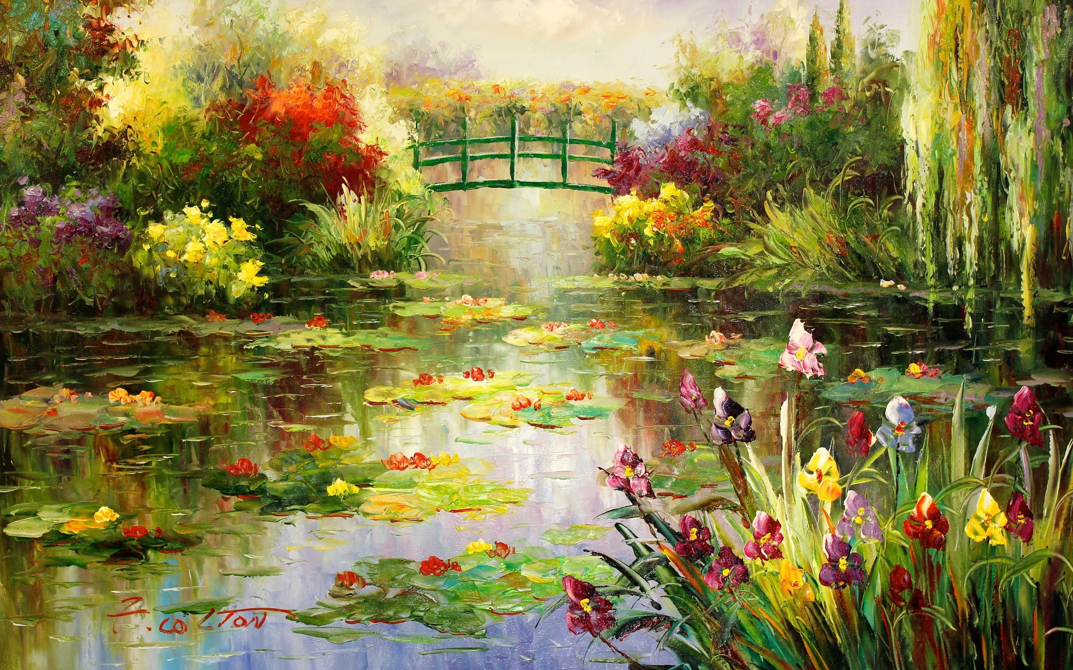
ArtGallery

Slide 2
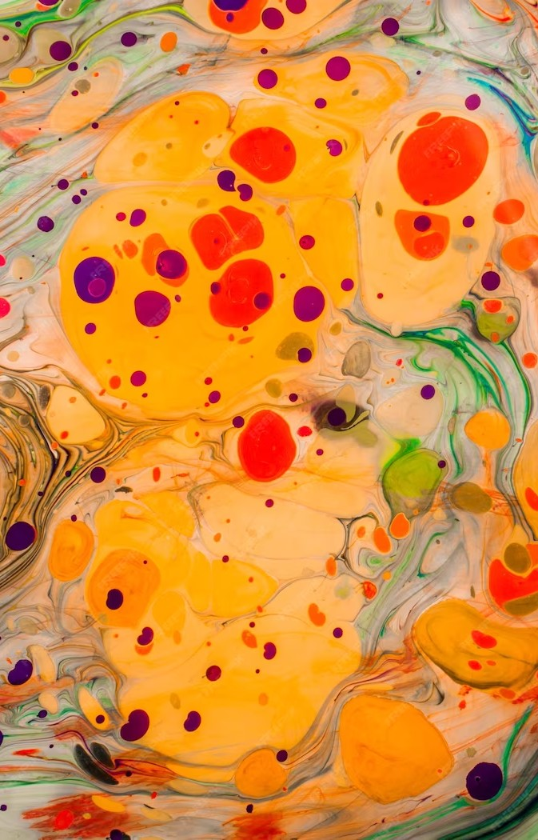

n Display: A Tour of [Art Gallery Name] and Its Iconic Collection

Slide 3
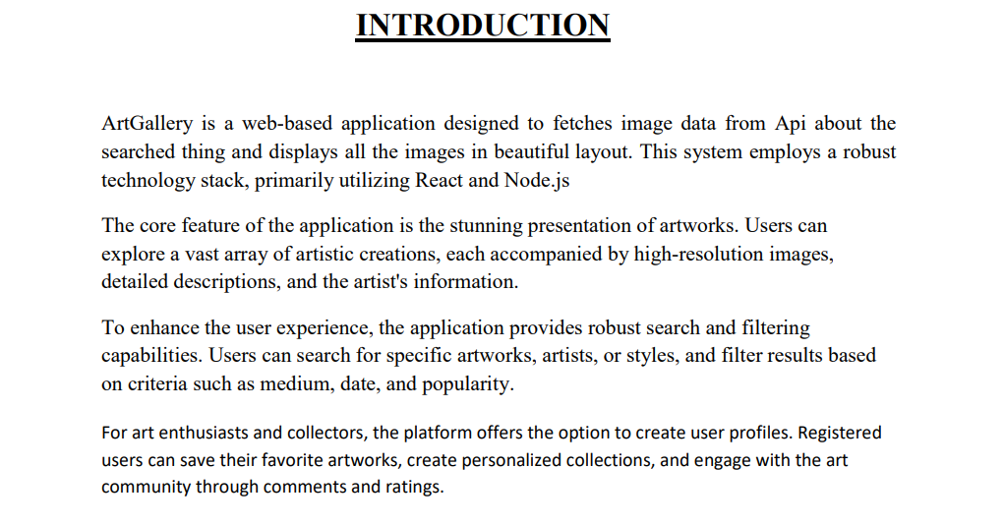

Slide 4
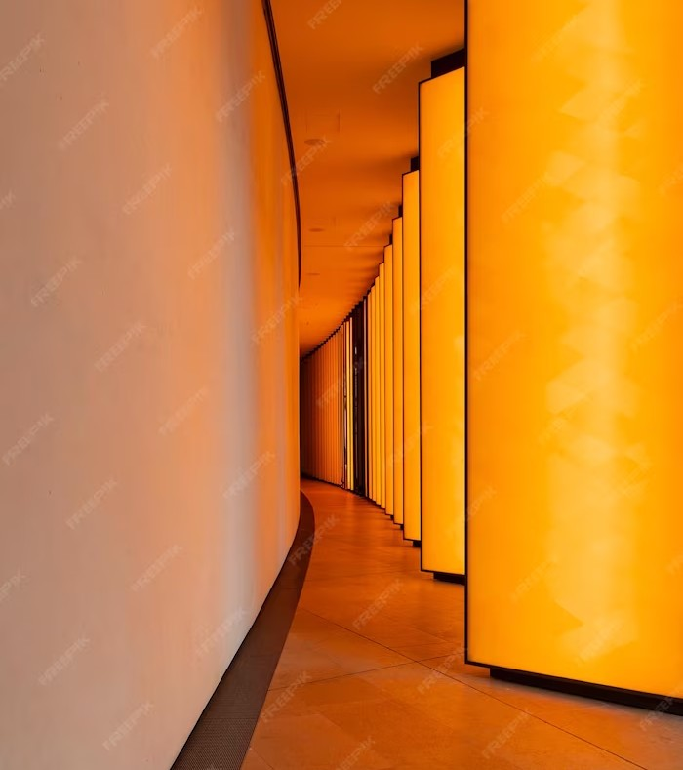
Software Requirement
Frontend: React
Backend: Node.js
Welcome to our tour of [Art Gallery Name]! Today we will explore the most iconic masterpieces on display. From the Renaissance to the Modern Era, our collection showcases some of the most inﬂuential artists in history. Join us on this journey through art and culture.

Slide 5
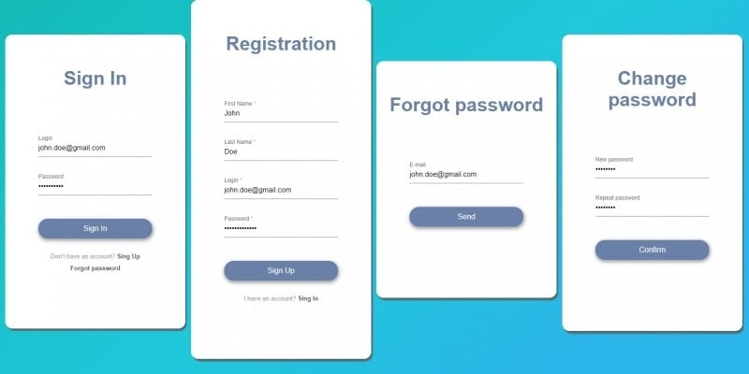
Modules

Slide 6
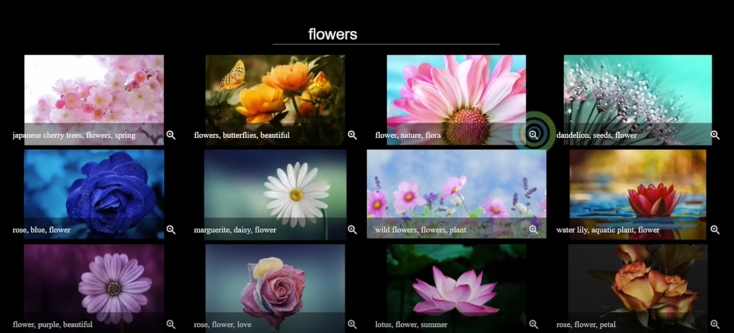
Modules

Slide 7
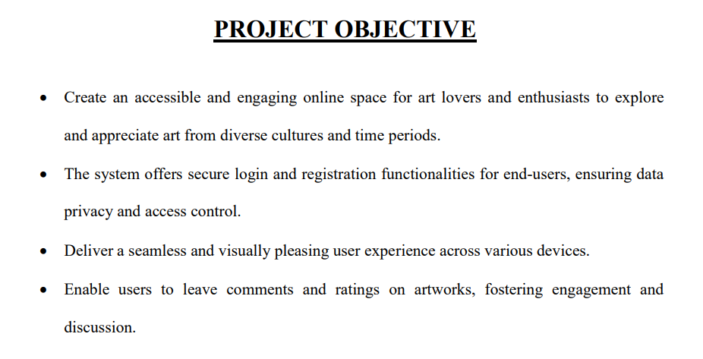

Slide 8

Conclusion
ArtGallery is a web-based application designed to fetches image data from Api about the searched thing and displays all the images in beautiful layout. This system offers login and registration functionalities for end users ensuring data privacy and access control. This system employa a robust technology stack, primarily utilizing react and Node.js

Slide 9
Gantt Chart
Phases
Requirement
Design
Development
Testing
Deployment
Week 1 | Week 2 | Week 3 | Week 4 | Week 5 | Week 6 | Week 7 | Week 8

Slide 10
Thanks!
Bittu Jaiswal
2200290140048

